Slide 1
CS542: DBMS
Record Representation

Slide 2
How Records are Stored on Disk
Two types of records
Fixed-Length Record
Variable-Length Record
All records have the same size
Different records may have different sizes
Check the record’s fields
If all fixed size ➔ Fixed-Length record
if any field is variable size ➔Variable-Length record

Slide 3
Fixed-Length Record Example
Create Table star (
  ID Int,
  Name char(30),
  Address char(255),
  Gender char(1),
  DOB Date)
4 bytes
30 bytes
255 bytes
1 byte
10 bytes
ID
name
address
gender
birth date

Slide 4
Variable-Length Record Example
Create Table star (
  ID Int,
  Name varchar2 (30),
  Address varchar2(255),
  Gender char(1),
  DOB Date)
Variable length and at most 255 bytes
ID
Name…
Address…
gender
birth date

Slide 5
Placing Records in Disk Blocks
assume fixed
length blocks
Blocks
File (relation)
assume a single file (for now)

Slide 6
Fixed-Length Records

Slide 7
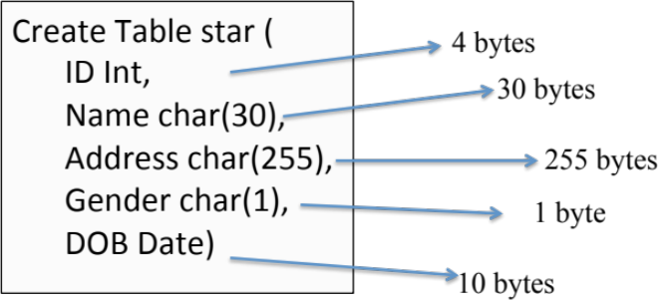
Representing Tuples
1- All fields are aligned to start at 4- or 8-byte boundaries
(Hardware and OS requirements) & concatenated
2- Each record has a header holding some info
ID
name
address
gender
birth date
header
4 bytes
32 bytes
256 bytes
4 bytes
12 bytes

Slide 8
Record Header
Often it is convenient to keep some "header" information in each record:
  A pointer to schema information (attributes/fields, types, their order in the tuple, constraints)
  Length of the record/tuple
  Timestamp of last modification
ID
name
address
gender
birth date
header
4 bytes
32 bytes
256 bytes
4 bytes
12 bytes

Slide 9
Packing Records into Blocks
Start with a block header:
  Timestamp of last modification/access
  Links to next and previous blocks in the big file
  Info about the records offsets !!!
Followed by sequence of records
May end with some unused space
One disk block
…
header
record 1
record 2
record n-1
record n
Block header

Slide 10
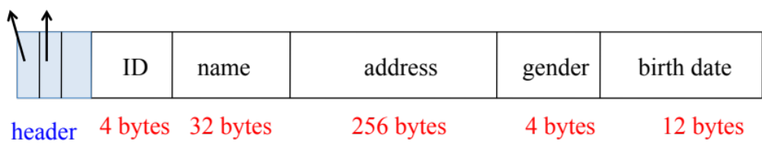
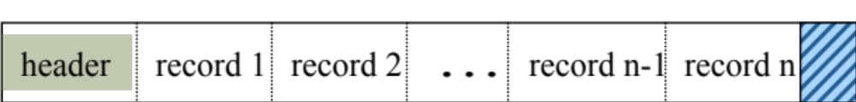
Access in Fixed-Length Records
Information about field types are same for all records in a file; stored in system catalogs.
Finding i’th field does not require scan over previous fields
Finding i’th record in a block does not require scan over previous records
Notes:
9

Slide 11
Variable-Length Records

Slide 12
Variable Length Data
Data items with varying size (e.g., if maximum size of a field is large but most of the time the values are small)
Variable-format records (e.g., NULLs method for representing a hierarchy of entity sets as relations)
Records that do not fit in a block (e.g., an MPEG of a movie)

Slide 13
Records with Variable Fields
An effective way to represent variable length records is as follows
Fixed length fields are kept ahead of the variable length fields
Record header contains
  Length of the record
  Pointers to the beginning of all variable
  length fields except the first one.

Slide 14
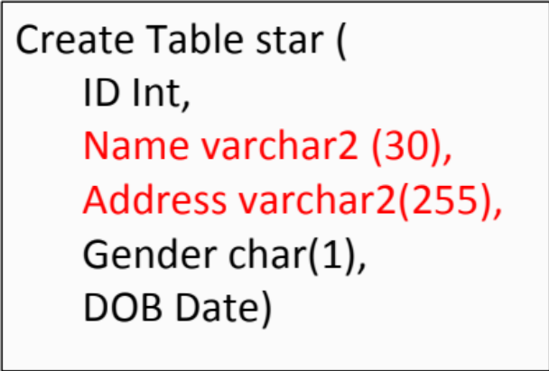
Records with Variable-Length Fields
Record length
Other header Info
Offset of Address
ID
gender
birth date
name
address

Slide 15
Extend to Multiple Fields
other
header
info
to var len
field 2
to var len
field 3
fixed len
field 1
fixed len
field 2
var len
field 1
var len
field 2
var len
field 3
record
length
Efficient access
Still reading the i^{th} field, does not require scanning over previous fields

Slide 16
Closer Look at
Packing Records into Blocks

Slide 17
Block Format : Fixed-Length Records
Packed Approach
Slot 1
Insertion
If enough free space (at the end) then insert in this block
Increment N
Slot 2
. . .
Free
Space
Slot N
Record id (rid) = <Block id, slot #>.
N
number
of records
Physical Address
Logical
Address
Deletion
Move the last record to fill in the empty space
Decrement N
Notes:
11

Slide 18
Block Format : Fixed-Length Records
Packed Approach
Slot 1
Slot 2
. . .
Free
Space
Record id (rid) = <Block id, slot #>.
Slot N
Physical Address
Logical
Address
N
number
of records
Goal:
Keep rid as is even if the data moves
In this approach, moving records for free space management ➔ changes Record id
Usually not acceptable to change the Record id
Notes:
11

Slide 19
Block Format : Fixed-Length Records
BitMap Approach
Slot 1
Every slot in the block has a bit (0 or 1)
Slot 2
Free
Space
. . .
Insertion
Find free slot any where in the block
Insert the record (increment N)
Set its bit to 1
Slot M
Slot N
1
. . .
0
1
1
N
Deletion (No movement)
Decrement N
Set its bit to 0
N ... 3 2 1
number
of slots
UNPACKED, BITMAP
That is a better approach, but wastes space
(we can do better)
Notes:
11

Slide 20
Block Formats: Variable-Length Records
Rid = (i,N)
Block (Page) i
Rid = (i,2)
Rid = (i,1)
20
16
24
N
Pointer
to start
of free
space
N . . . 2 1
# slots
Offset within the block at which the record starts
SLOT DIRECTORY
The slot directory starts from one end
The data records start from the other end (No space is wasted)
Notes:
12

Slide 21
Block Formats: Variable-Length Records
Rid = (i,N)
rids
Block (Page) i
Rid = (i,2)
Rid = (i,1)
20
16
24
N
Pointer
to start
of free
space
N . . . 2 1
# slots
Offset within the block at which the record starts
SLOT DIRECTORY
Record id (rid) = <Block id, slot #>.
Notes:
12

Slide 22
Block Formats: Variable-Length Records
Rid = (i,N)
Block (Page) i
Rid = (i,2)
Rid = (i,1)
20
16
24
N
Pointer
to start
of free
space
N . . . 2 1
# slots
Offset within the block at which the record starts
SLOT DIRECTORY
Can move records on page without changing rid.
So, attractive for fixed-length records too.
Notes:
12

Slide 23
Example: Delete rid = (i, 2)
Rid = (i,N)
Block (Page) i
Rid = (i,2)
Rid = (i,1)
20
16
24
N
Pointer
to start
of free
space
N . . . 2 1
# slots
Offset within the block at which the record starts
SLOT DIRECTORY
And move rid (i,N) in its place
Notes:
12

Slide 24
Example: Delete rid = (i, 2)
Rid = (i,N)
Block (Page) i
Rid = (i,2)
Rid = (i,1)
16
X
N
Pointer
to start
of free
space
20
16
24
N . . . 2 1
# slots
Offset within the block at which the record starts
SLOT DIRECTORY
And move rid (i,N) in its place
Notice that rid = (i,N) is still the same to outside world
Notes:
12

Slide 25
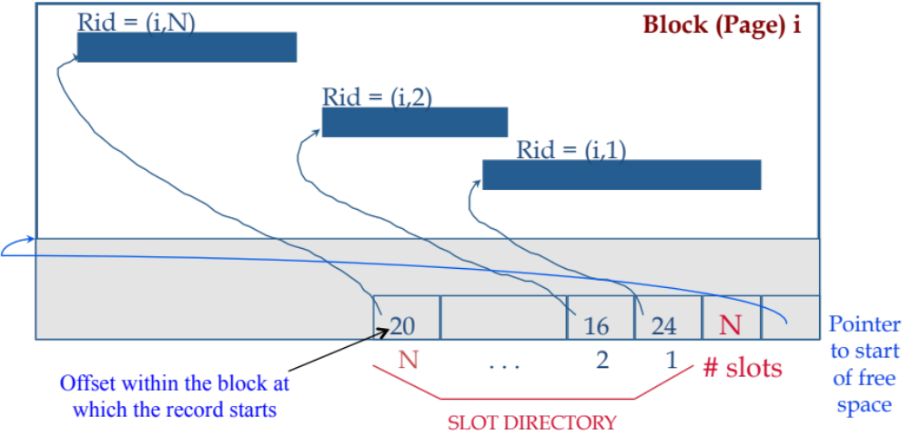
Indirection: Physical vs. Logical Addresses
This approach of addressing the records combines physical and logical addresses
Record id (rid) = <Block id, slot #>.
Physical Address (which disk, platter, track and sector)
Logical
Address
Notes:
12

Slide 26
Record Modification

Slide 27
Record Modification
Modifications to records:
  Insert
  Delete
  Update
Issues even with fixed-length records and fields
Even more complex with variable-length data

Slide 28
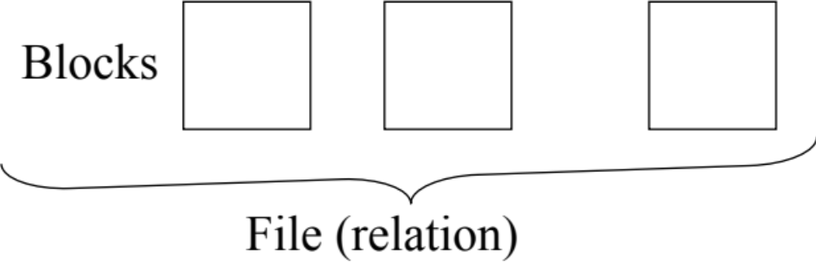
Inserting New Records
If records need not be any particular order, then just find a block with enough empty space
Later we'll see how to keep track of all the tuples of a given relation
But what if blocks should be kept in a certain order, such as sorted on primary key?

Slide 29
Insertion Example
header
unused
record
4
record
3
record
2
record
1
If there is space in the block, then add the record
(going right to left), add a pointer to it (going left
to right) and rearrange the pointers as needed.

Slide 30
Insertion Example (Our Block)
Rid = (i,N)
Block (Page) i
Rid = (i,2)
Rid = (i,1)
Rid = (i,M)
70
20
16
24
M
M
N . . . 2 1
# slots

Slide 31
What if Insertion in Order& Block is Full?
If records have to follow specific order
The desired block has no space
One approach: keep a linked list of "overflow" blocks for each block in the main sequence
Desired Block (B1)
B1-Overflow
(extension)

Slide 32
Deleting Records: Two Approaches
1- Try to reclaim space made available after a record is deleted
2- Not re-use this rid again

Slide 33
Example: Delete rid = (i, 2)
Rid = (i,N)
Block (Page) i
Rid = (i,2)
Rid = (i,1)
16
X
N
Pointer
to start
of free
space
20
16
24
N . . . 2 1
# slots
Offset within the block at which the record starts
SLOT DIRECTORY
In this relation, no record will have rid = (i.2) again
Notes:
12

Slide 34
Updating Records
For fixed-length records, there is no effect on the storage system
For variable-length records:
  if length increases, like insertion
  if length decreases, no problem (some space wasted) ➔ Can be claimed later

